Slide 1


Standing on the Shoulders of Giants:
New strategies to involve more of the world with data mining and intelligence extraction.
Dr. Steven Muskal
Chief Executive Officer
Eidogen-Sertanty, Inc.
smuskal@eidogen-sertanty.com

Slide 2

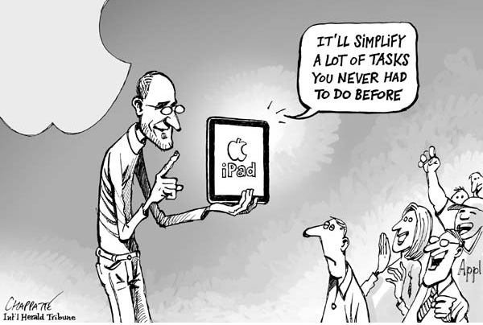
* Apple’s iPad was first released in April 2010.

Slide 3
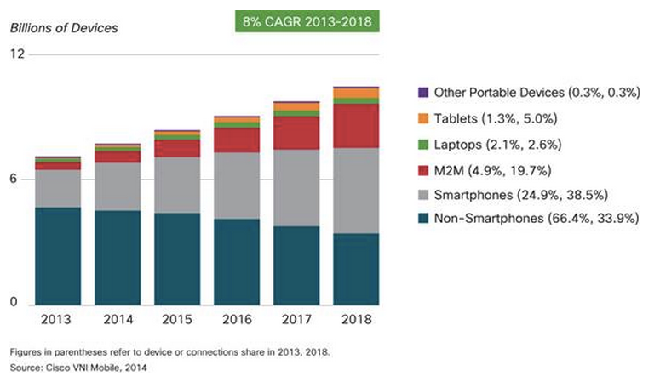
70% of World’s Population Uses Mobile Devices
Over half a billion mobile devices and connections were added in 2013
http://www.cisco.com/c/en/us/solutions/collateral/service-provider/visual-networking-index-vni/white_paper_c11-520862.html

Slide 4
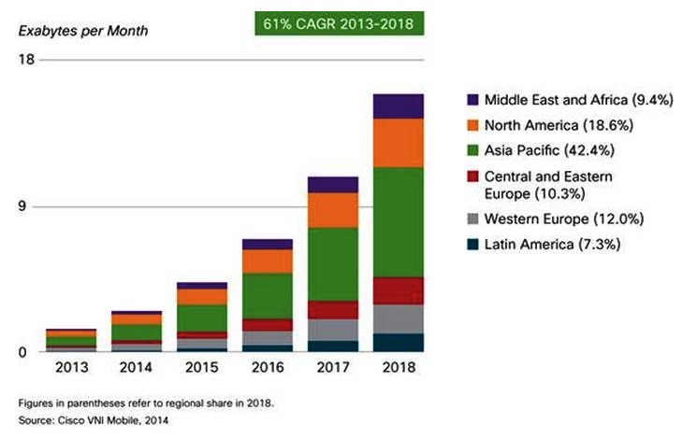
Growing World Demand for Connectivity
Asia Pacific and North America will account for two-thirds of global mobile traffic by 2018
http://www.cisco.com/c/en/us/solutions/collateral/service-provider/visual-networking-index-vni/white_paper_c11-520862.html

Slide 5
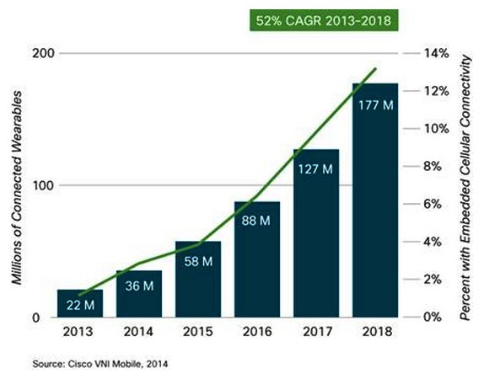
Spoiler Alert: Wearables

Slide 6

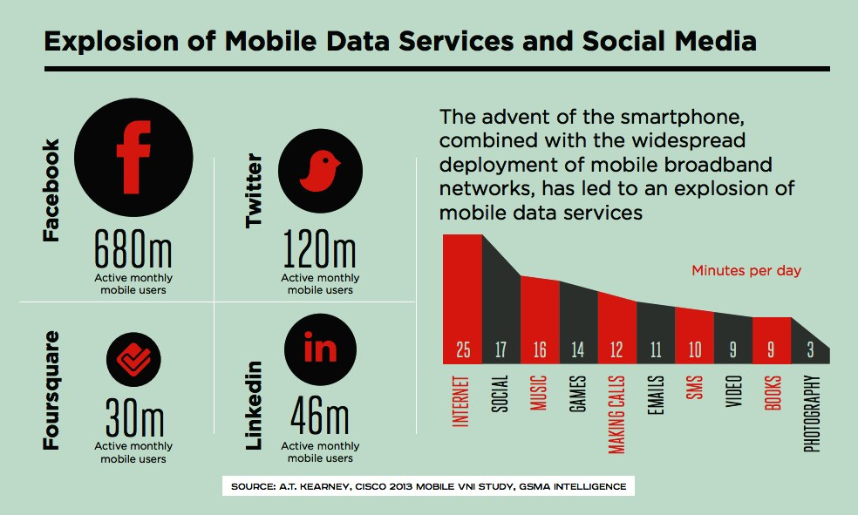
Mobile Social Networking
* March 2014: Facebook reported 1 Billion Active Mobile Users

Slide 7

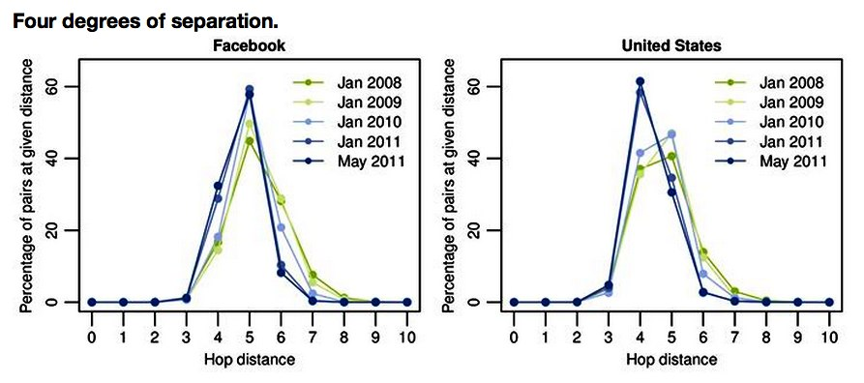

Less Than Four Degrees of Separation

Slide 8

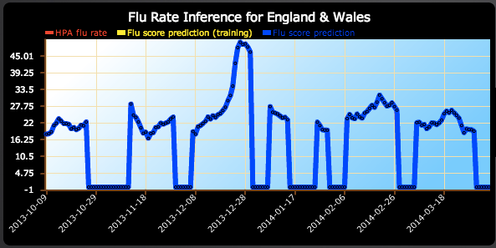
Tracking Epidemics and Other Public Health Issues
Flu Detector - Tracking Epidemics on Twitter
Machine Learning and Knowledge Discovery in Databases Lecture Notes in Computer Science Volume 6323, 2010, pp 599-602 Lampos, V. and Cristianini, N.
Tweet: “Poor little crumb’s got fever and red spots. I feel so sorry.”
Tweet: “Coughed the whole night. I got it bad. Flu.”
> 95% correlation with Health Protection Agency Data
http://geopatterns.enm.bris.ac.uk/epidemics/
http://www.nydailynews.com/life-style/health/cough-cough-tweet-researchers-twitter-track-flu-article-1.1253136

Slide 9

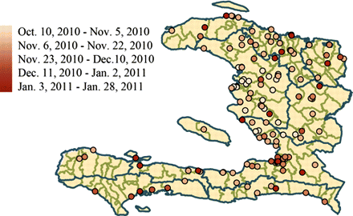
Tracking Epidemics and Other Public Health Issues
Social and News Media Enable Estimation of Epidemiological Patterns Early in the 2010 Haitian Cholera Outbreak
HealthMap alerts for the first one hundred days of the Haiti cholera outbreak.
Cholera-related HealthMap news media reports, Twitter postings, and government cholera cases reported strongly correlated with official case data.
Data from Informal sources were available up to 2 weeks earlier!
Am. J. Trop. Med. Hyg., 86(1), 2012, pp. 39-45 doi:10.4269/ajtmh.2012.11-0597

Slide 10


Cloud Computing - A Revolution…
Nov 12, 2006

Slide 11
Quick Poll
How Many of You Leverage “the Cloud?”
Gmail Users?
Dropbox?
Use an iPhone or iPad?

Slide 12
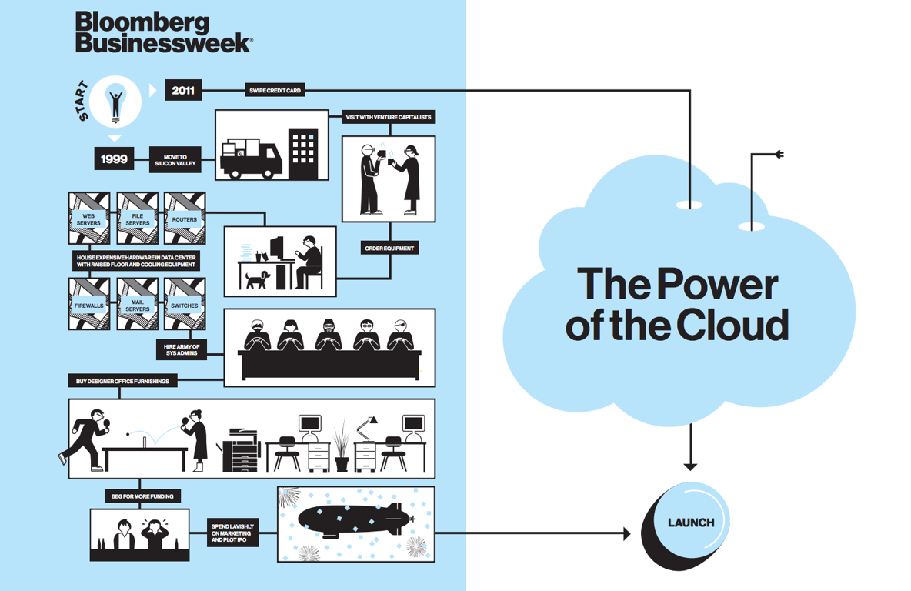

Slide 13
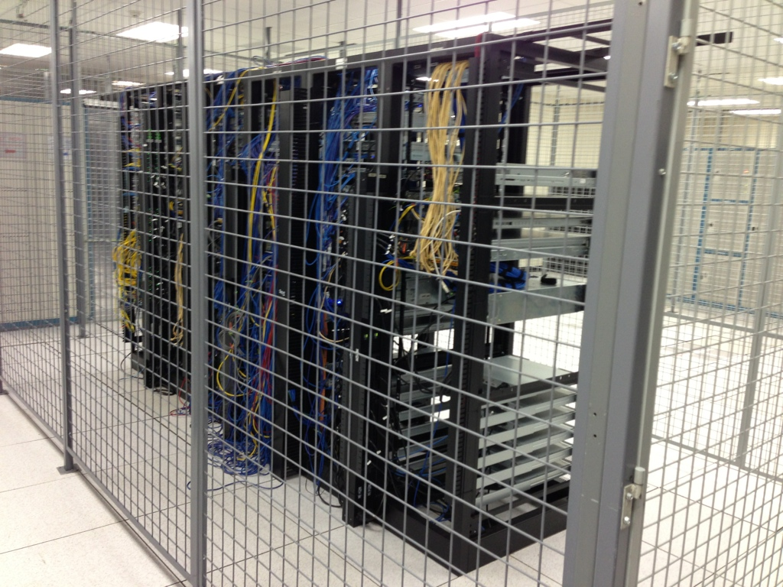
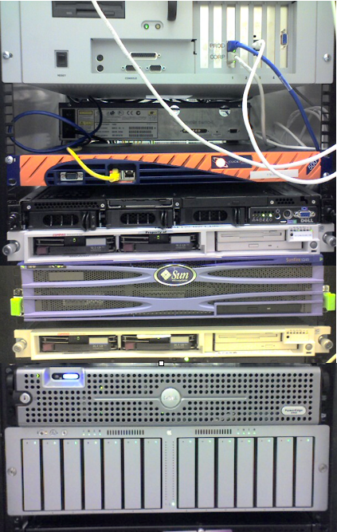
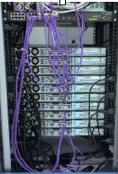
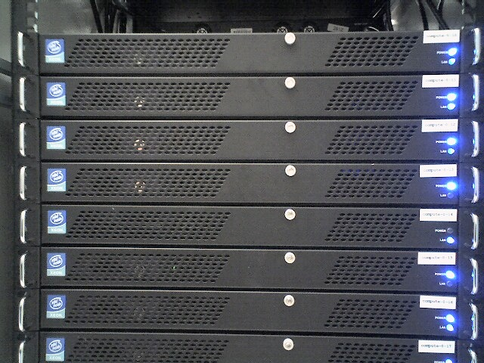
Eidogen Cloud Migration
2003-2005: 3 different server rooms: 120+ servers
2005-2010: 1 colocation center: 5 caged racks
2010-2012: 1 colocation center: 3 racks + EC2/RDS cloud instances (mobile apps and migration)
2012-2013: EC2/RDS cloud instances (primary) + 2 legacy racks (“fallback”)

Slide 14
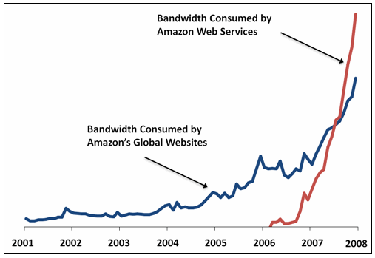
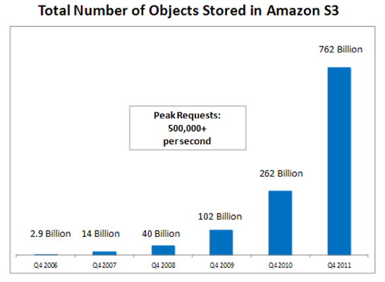
The Cloud: Amazon AWS Growth
In January 2008, Amazon announced that the Amazon Web Services consume more bandwidth than its entire global network of Amazon.com retail sites
Amazon S3 grew 192% year-over-year
http://aws.typepad.com/aws/2008/05/lots-of-bits.html
AWS Free Usage Tier now includes Amazon MS-Windows Server EC2 instances
February 23, 2012
http://venturebeat.com/2012/01/31/amazon-aws-s3-growth-cloud/

Slide 15

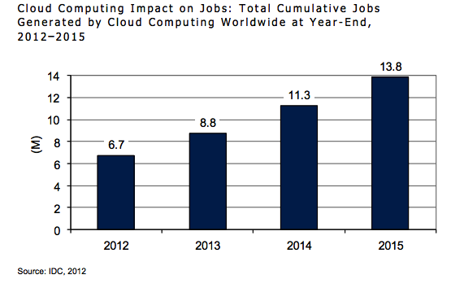
Jobs Generated by Cloud Computing
U.S. number of unemployed persons (10.5 million) - i.e. unemployment rate (6.7 percent)
April 4, 2014: http://www.bls.gov/news.release/empsit.nr0.htm

Slide 16

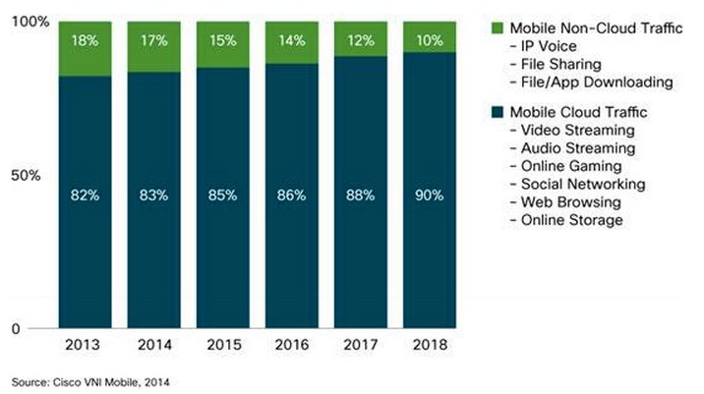
Mobile and Cloud
Cloud Applications Will Account for 90 Percent of Mobile Data Traffic by 2018

Slide 17
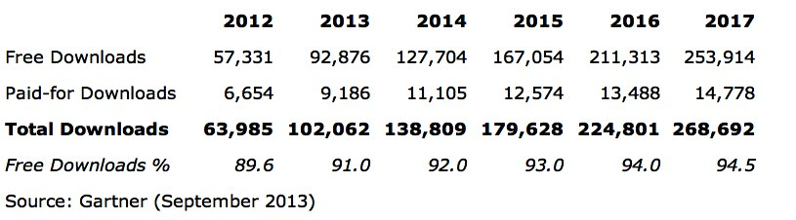
Many Apps, Huge Download Numbers
Total Apps Approved for iTunes App Store: 1,542,115
Total Active Apps (currently available for download): 1,157,279
Total Inactive Apps (no longer available for download): 384,836
Number of Active Publishers in the iTunes App Store: 300,572
March 31, 2014: http://148apps.biz/app-store-metrics
> 100 Billion Downloads!

Slide 18

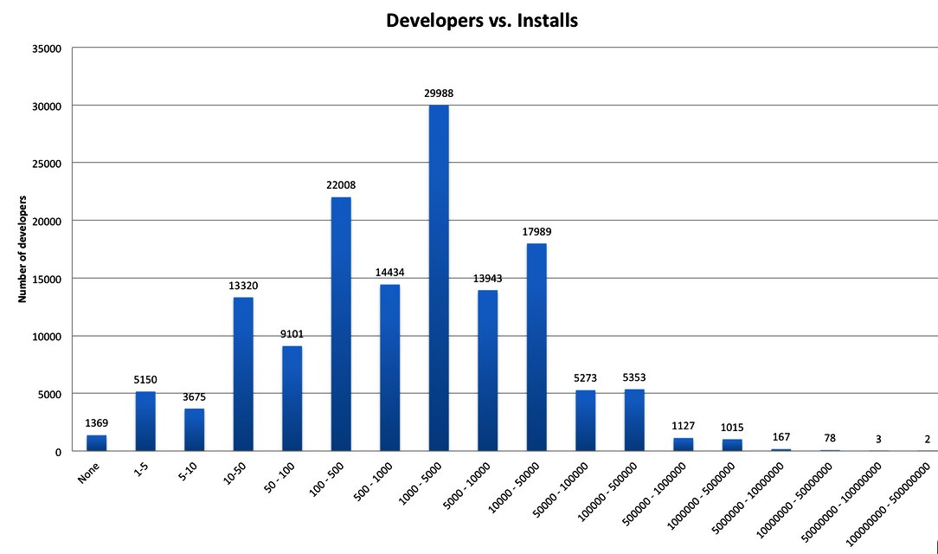
However, Market Awareness Is Challenging…
Android
January 28, 2012: http://www.quora.com/appbackr

Slide 19
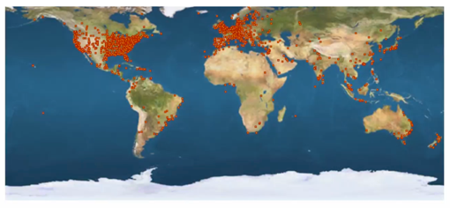
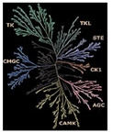
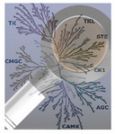










Eidogen’s Apps: More than 50K Downloads
In partnership with Intel
In partnership with Molecular Materials Informatics,
with InfoChem
In partnership with Accelrys

Slide 20
Science-Cloud Tasks (Eidogen/Accelrys)
What is it?
An iOS application for iPod/iPhone/iPad (Android planned)
A new Pipeline Pilot component collection
What does it do?
Allow any Pipeline Pilot PDF and HTML report to be easily deployed to mobile devices
Allow authoring of new Pipeline Pilot protocols to deploy dashboards and mobile-centered tasks and actions on mobile devices
Free App from Apple AppStore (search ‘Accelrys’)

Slide 21
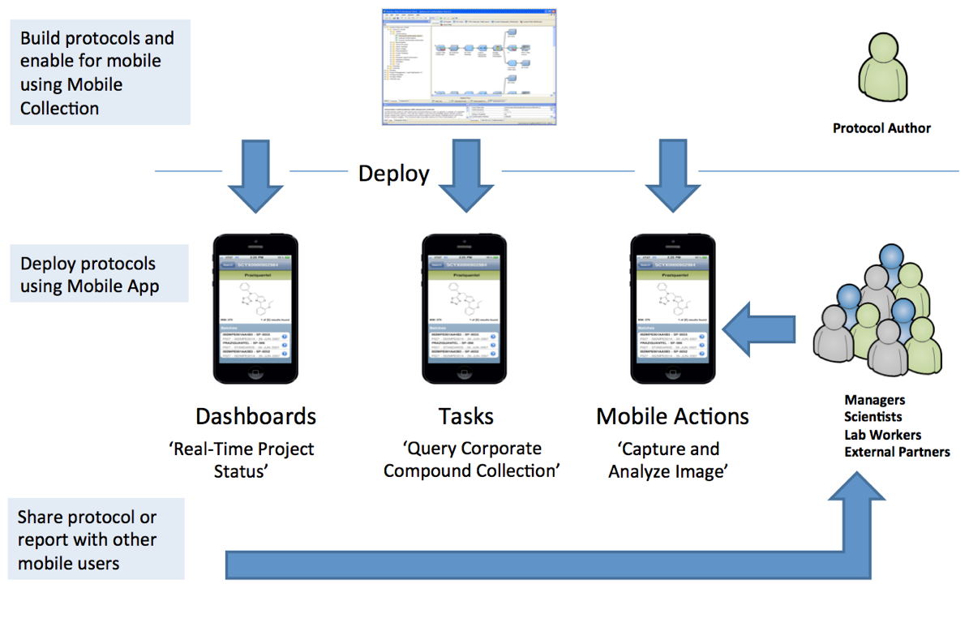
New Mobile Possibilities...
ScienceCloud Tasks / Mobile Collection

Slide 22

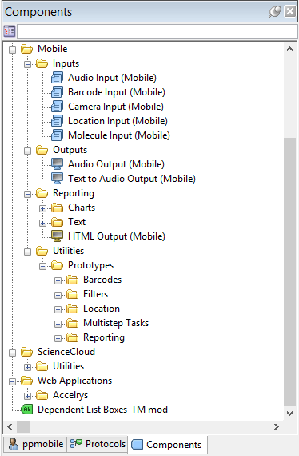

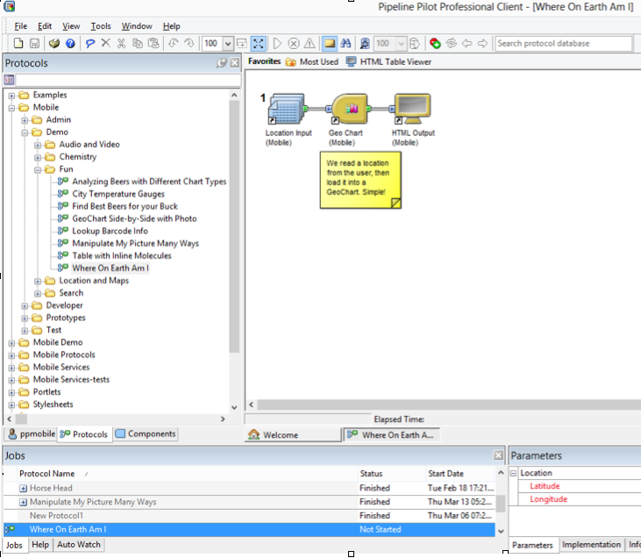
Pipeline Pilot Protocols are Easily ‘Mobilized’

Slide 23
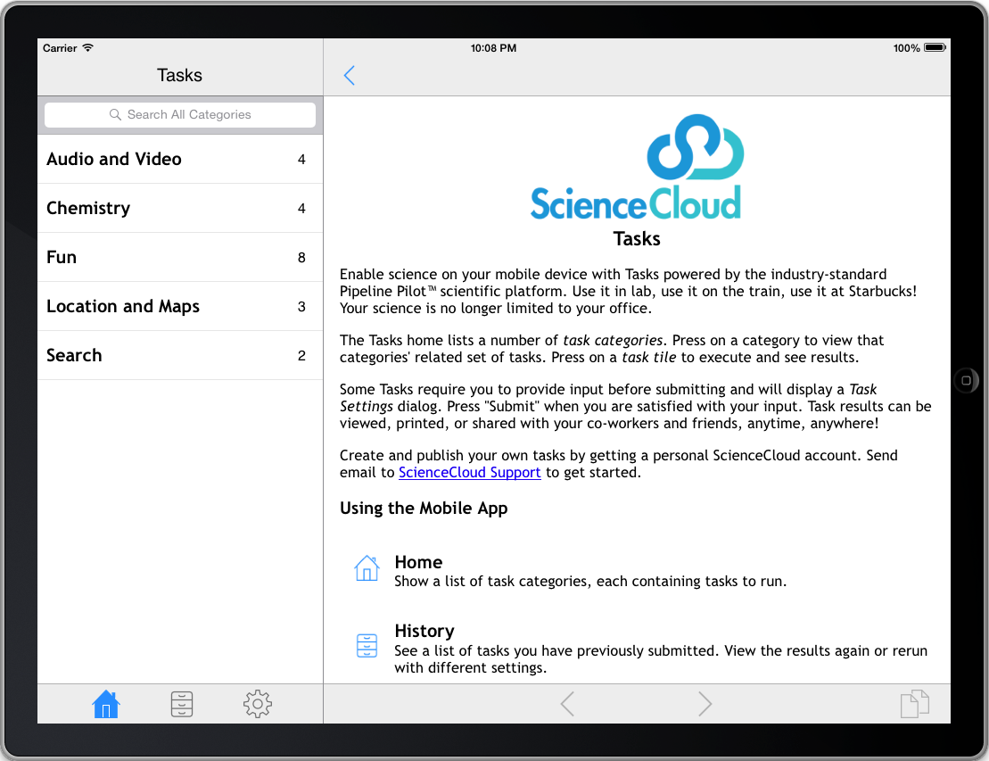
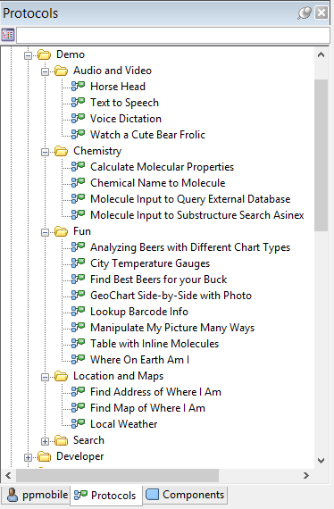
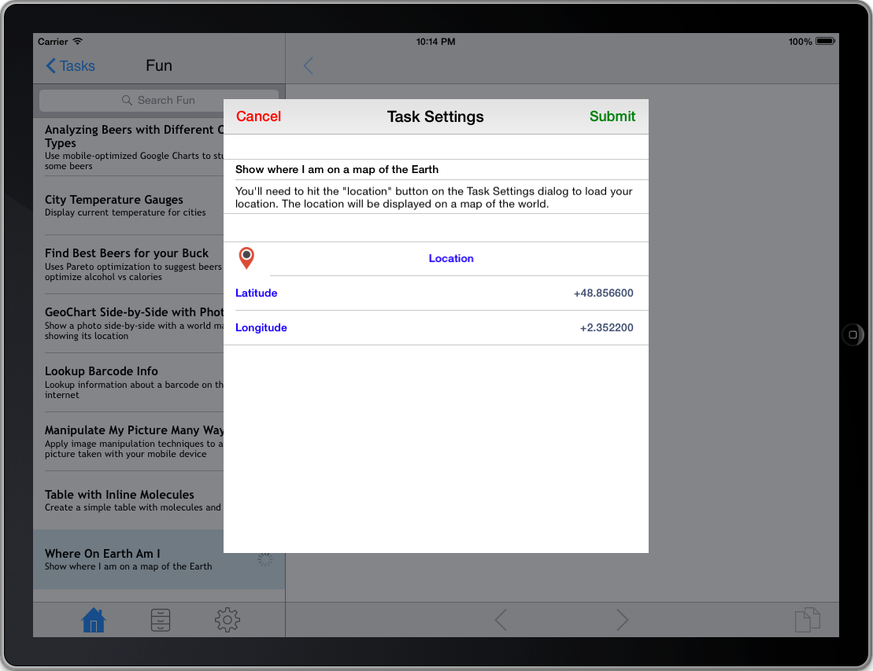
Protocol Folders Appear in the Tasks App

Slide 24
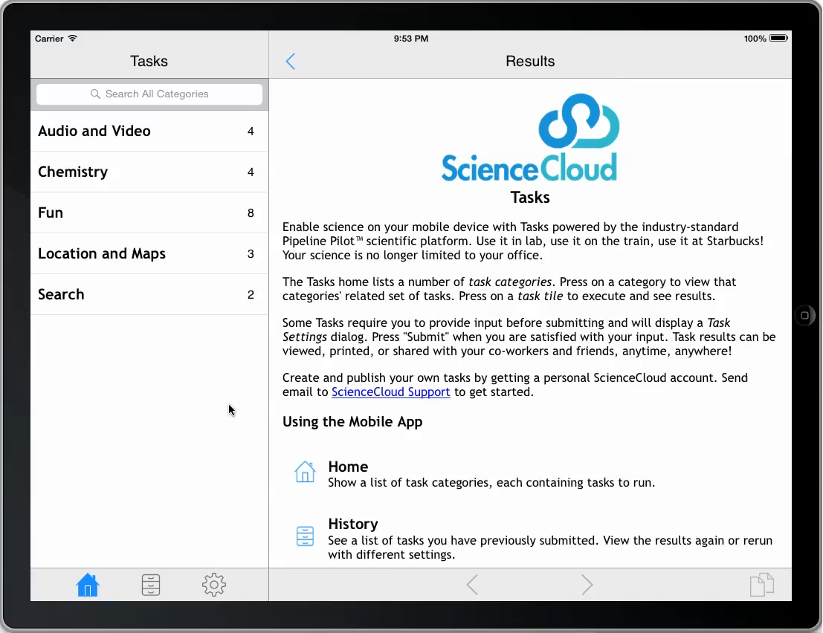
Location (Demo)

Slide 25
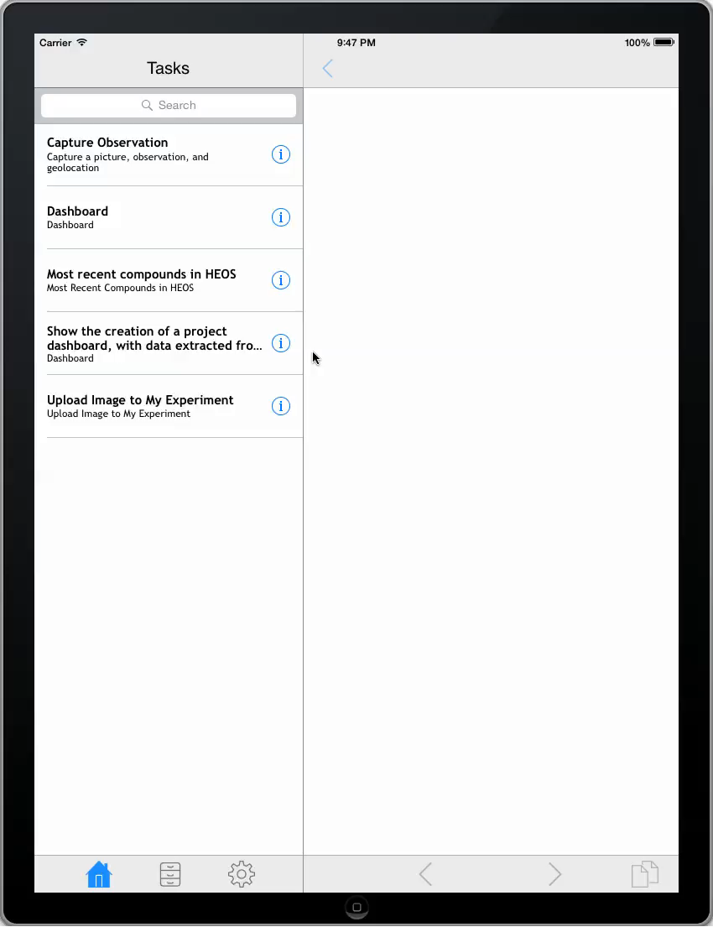

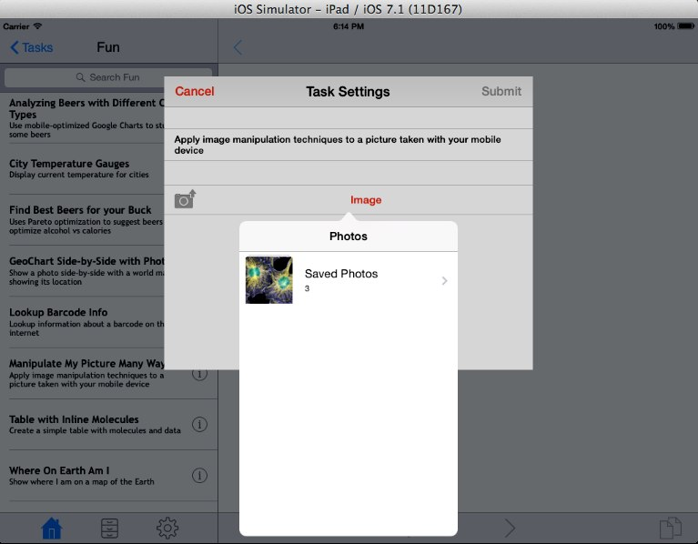

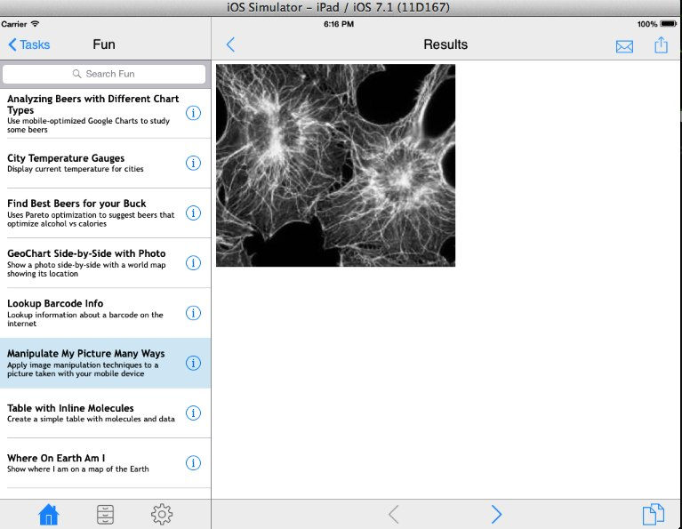
Observation Capture (Demo)
Leverage Mobile Device Capabilities
Camera, Audio, GPS, etc.

Slide 26

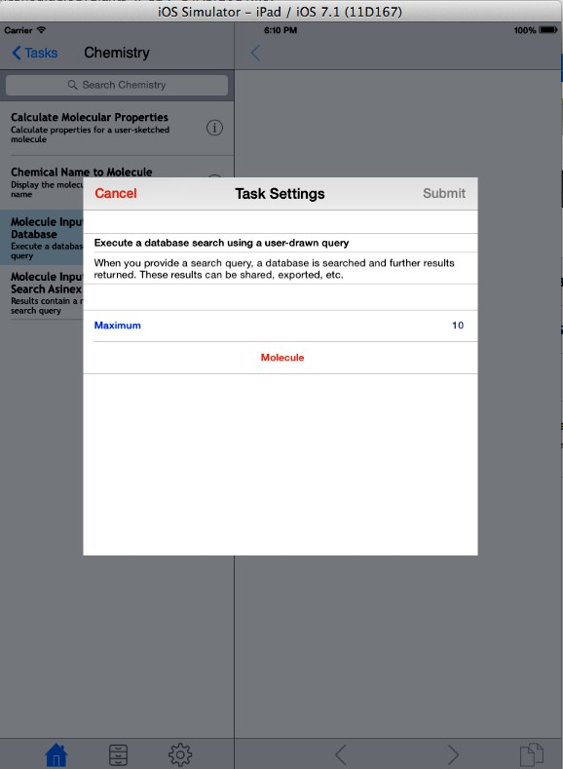

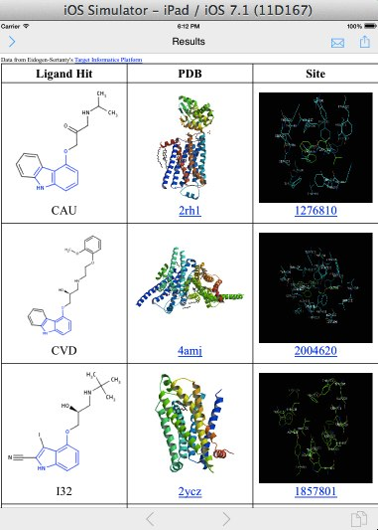

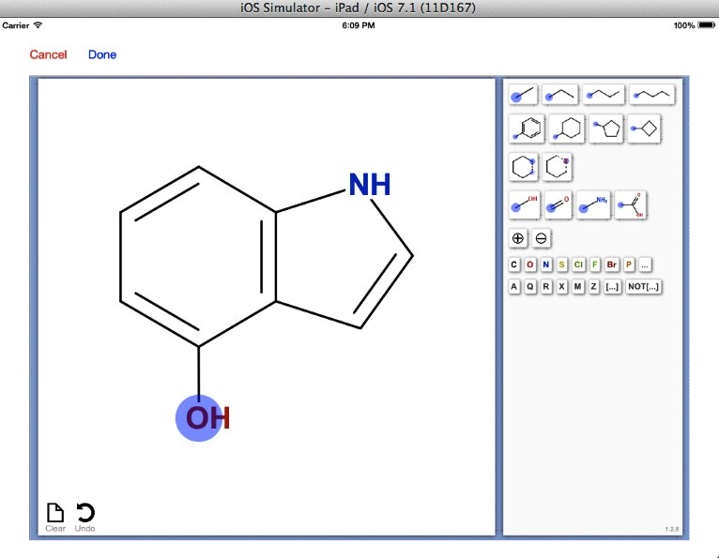
Embed and Deploy
Embed full applications within Pipeline Pilot protocols and deploy to mobile users

Slide 27
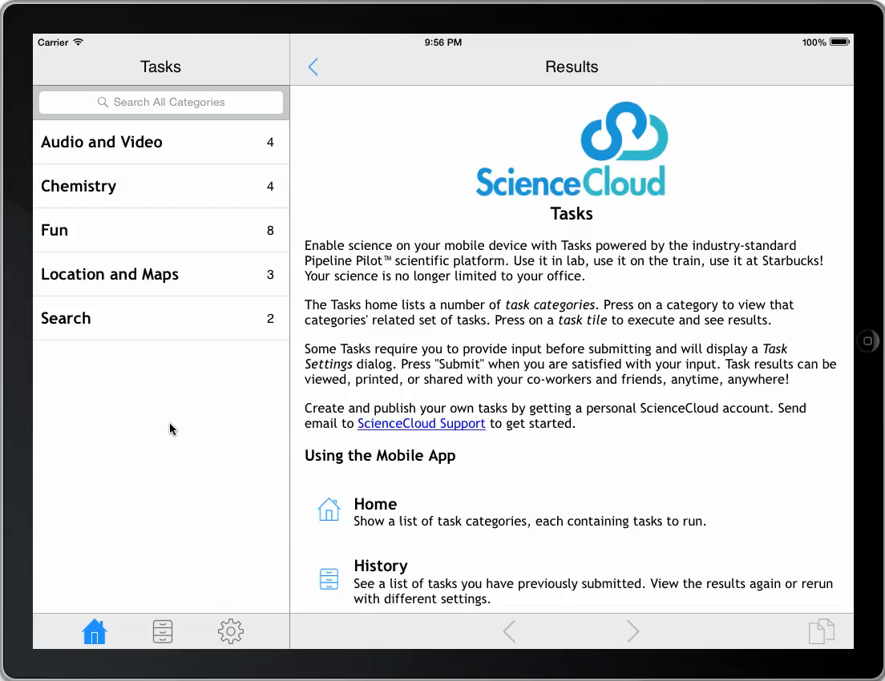
Ligand Co-Complex Search (Demo)

Slide 28
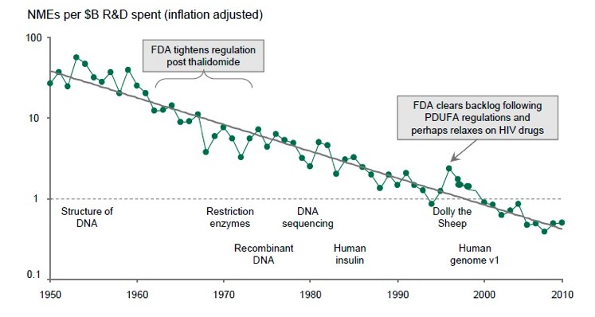
R&D Productivity Has Been On The Decline

Slide 29
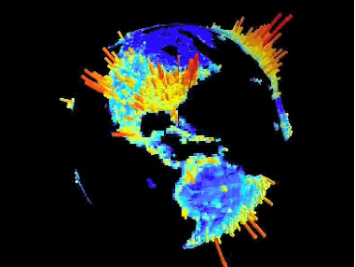
7 Billion people depend on fewer than 500,000 people to discover and develop new medicines.
Let’s find a way to shift the numbers…
World Population Density
The G-Econ project gecon.yale.edu/

Slide 30
Summary
Billions of people routinely use and connect with mobile devices.
Massive worldwide connectivity is unprecedented.
Well deployed social media frameworks are in-place and easy to access.
e.g. Facebook, Twitter, and their APIs.
Science apps have been largely insular, vertical, and point solutions. We need to recruit more of the world!
Cloud-based pipelining-tools, social media frameworks, and mobile devices together open many new possibilities.

Slide 31
Acknowledgements
Accelrys
Matt Hahn
Dave Rogers
Jung Ku
Mike Peeler
Ton van Daelen
Maurizio Bronzetti
Stephan Schurer
Alex Clark

Slide 33
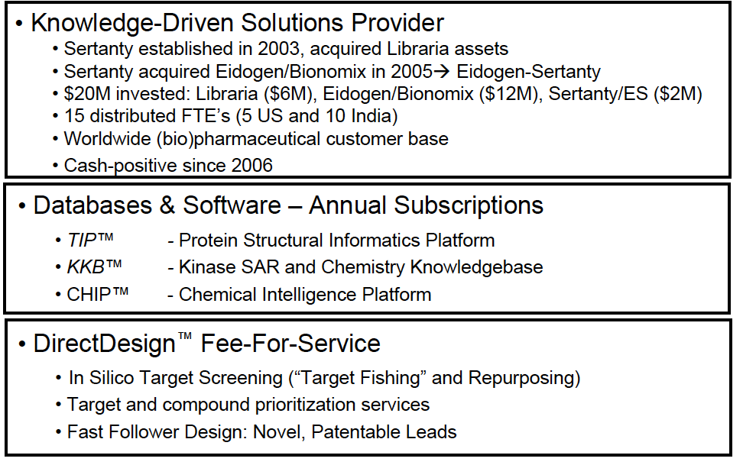
About Eidogen-Sertanty, Inc.

Slide 34
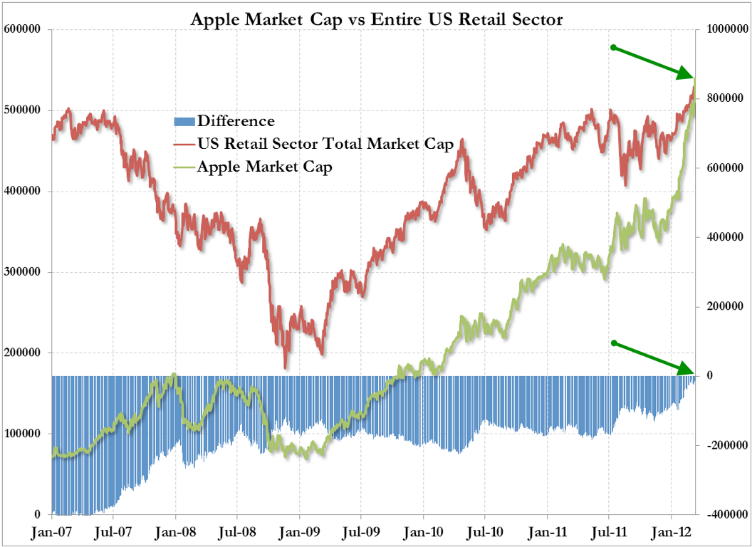
Apple Market Cap = US Retail Sector Total Market Cap
(as defined by the S&P 500)
Source: http://www.zerohedge.com/news/its-official-apple-now-bigger-entire-us-retail-sector

Slide 35
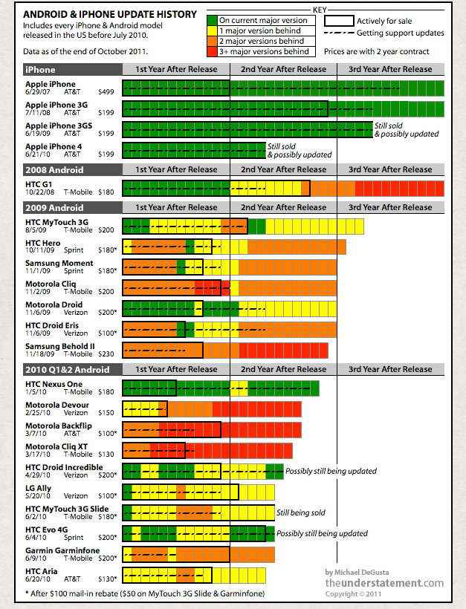
Advantages iOS
Minimal fragmentation
Nice development environment
Better tablet support
Apple is a powerhouse
“Apple App Store Generates Twice As Much Revenue As Android Market In 2011” Distimo
Advantages Android
Java-based
Several development environments available
Many powerful devices
Many hardware vendors
http://techcrunch.com/2011/10/27/charted-android-fragmentation/
http://www.gottabemobile.com/2011/12/21/app-store-data-analyzed/

Slide 36

Dynamic Charting (Demo)

