Slide 1


New strategies to engage more of the world with scientific app development and content deployment.
Dr. Steven Muskal
Chief Executive Officer
Eidogen-Sertanty, Inc
smuskal@eidogen-sertanty.com

Slide 2
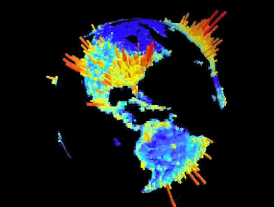
  7 Billion people depend on fewer than 500,000 people to discover and develop new medicines.
World Population Density
The G-Econ project gecon.yale.edu/

Slide 3
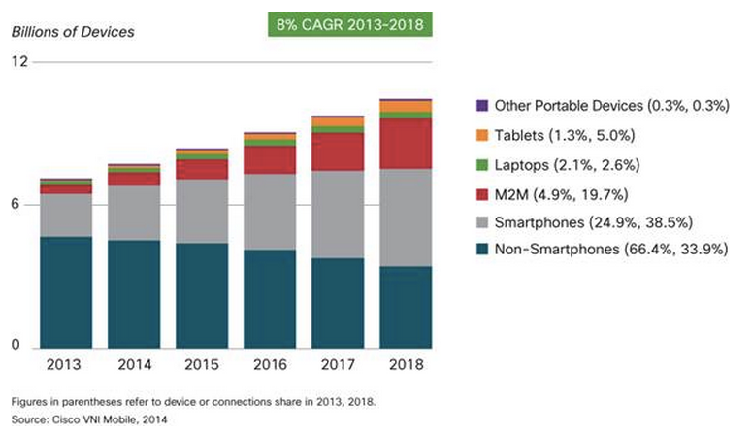
70% of World’s Population Uses Mobile Devices
Over half a billion mobile devices and connections were added in 2013
http://www.cisco.com/c/en/us/solutions/collateral/service-provider/visual-networking-index-vni/white_paper_c11-520862.html

Slide 4
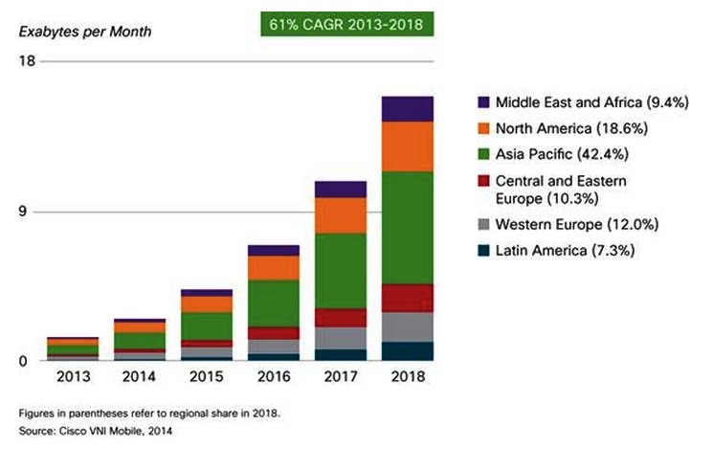
Growing World Demand for Connectivity

Slide 5

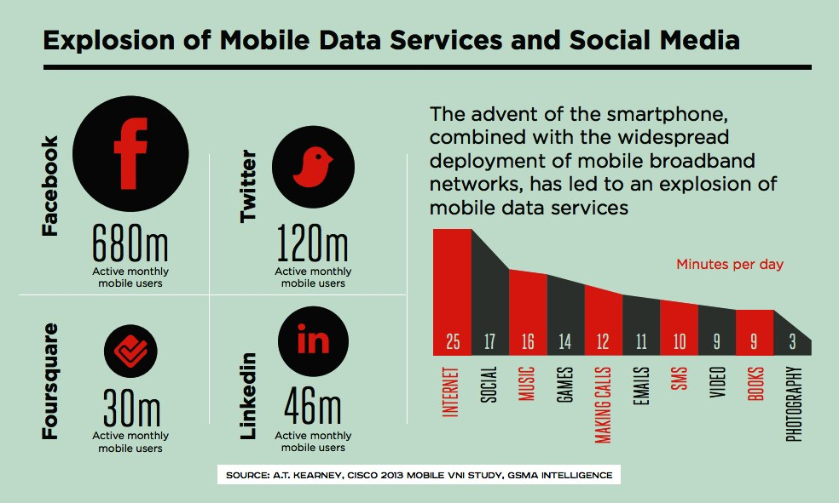
Mobile Social Networking
  August 2014:
    Facebook: 1.3 Billion Monthly Active Mobile Users
    Twitter: ~700 tweets/second (average: 58 million tweets/day)
http://www.statisticbrain.com/facebook-statistics/ http://www.statisticbrain.com/twitter-statistics/

Slide 6

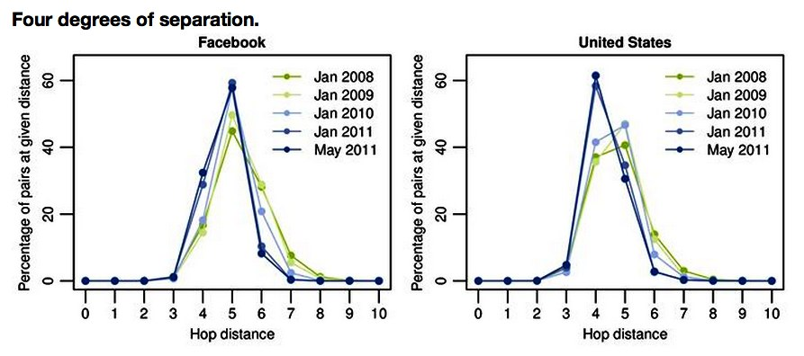

Less Than Four Degrees of Separation

Slide 7

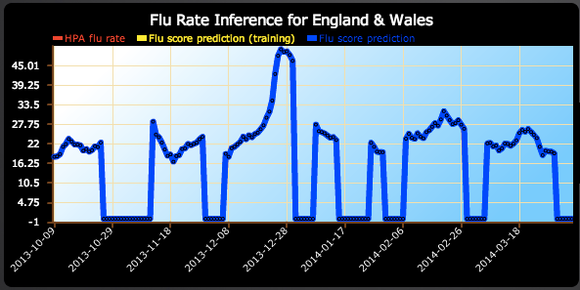
Tracking Epidemics and Other Public Health Issues
Flu Detector - Tracking Epidemics on Twitter
Machine Learning and Knowledge Discovery in Databases Lecture Notes in Computer Science Volume 6323, 2010, pp 599-602 Lampos, V. and Cristianini, N.
Tweet: “Poor little crumb’s got fever and red spots. I feel so sorry.”
Tweet: “Coughed the whole night. I got it bad. Flu.”
> 95% correlation with Health Protection Agency Data
http://geopatterns.enm.bris.ac.uk/epidemics/
http://www.nydailynews.com/life-style/health/cough-cough-tweet-researchers-twitter-track-flu-article-1.1253136

Slide 8

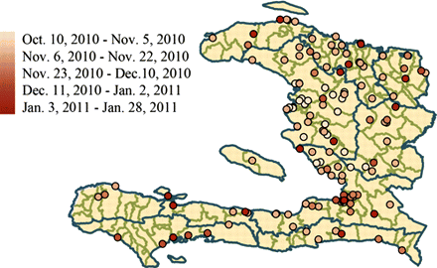
Tracking Epidemics and Other Public Health Issues
Social and News Media Enable Estimation of Epidemiological Patterns Early in the 2010
Haitian Cholera Outbreak
HealthMap alerts for the first one hundred days of the Haiti cholera outbreak.
Cholera-related HealthMap news media reports, Twitter postings, and government cholera cases reported strongly correlated with official case data.
Data from Informal sources were available up to 2 weeks earlier!
Am. J. Trop. Med. Hyg., 86(1), 2012, pp. 39-45 doi:10.4269/ajtmh.2012.11-0597

Slide 9
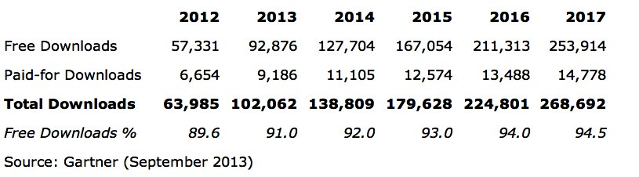
Many Apps, Huge Download Numbers
Total Apps Seen in iTunes App Store: 1,367,788
  Total Active Apps (currently available for download): 1,139,599
  Total Inactive Apps (no longer available for download): 228,189
Number of Active Publishers in the iTunes App Store: 285,489
August 4, 2014: http://148apps.biz/app-store-metrics
  > 100 Billion Downloads!

Slide 10
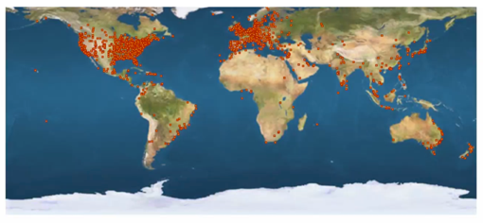
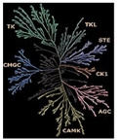
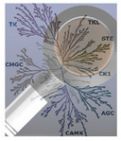










Eidogen’s Apps: More than 50K Downloads
In partnership with Intel
In partnership with Molecular Materials Informatics,
with InfoChem
with Accelrys/BIOVIA

Slide 11

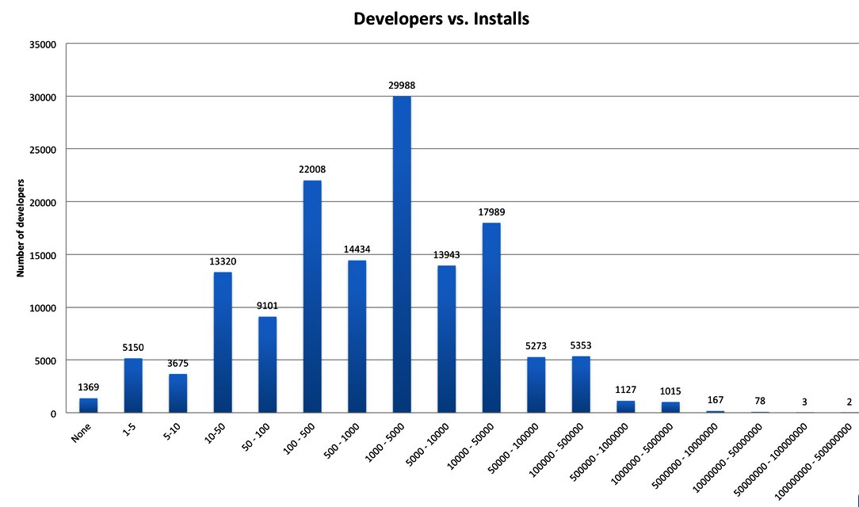
However, Market Awareness Is Challenging…
Android:
http://www.quora.com/Mobile-App-Distribution-Platforms/How-many-developers-companies-have-submitted-an-app-to-the-iOS-App-Store-or-Android-Market
January 28, 2012

Slide 12
Science-Cloud Tasks (Eidogen/Accelrys-BIOVIA)
What is it?
  An iOS application for iPod/iPhone/iPad (Android planned)
  A new Pipeline Pilot component collection - “Mobile Collection”
What does it do?
  Allow any Pipeline Pilot PDF and HTML report to be easily deployed to mobile devices
  Allow authoring of new Pipeline Pilot protocols to deploy dashboards and mobile-centered tasks and actions on mobile devices
Free App from Apple AppStore (search ‘Accelrys’)

Slide 13
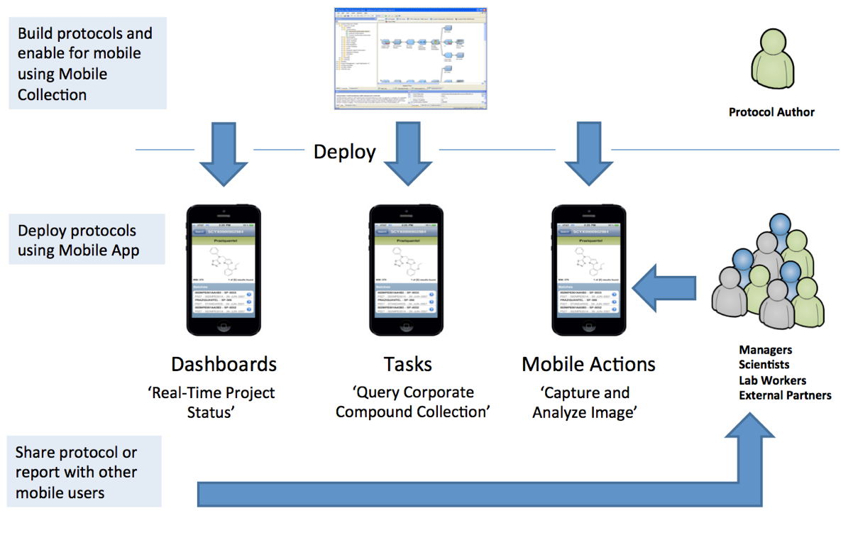
New Mobile Possibilities...
ScienceCloud Tasks / Mobile Collection

Slide 14


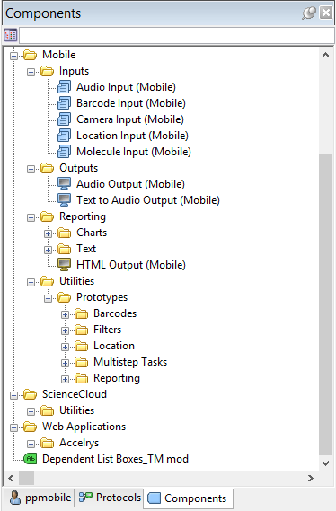
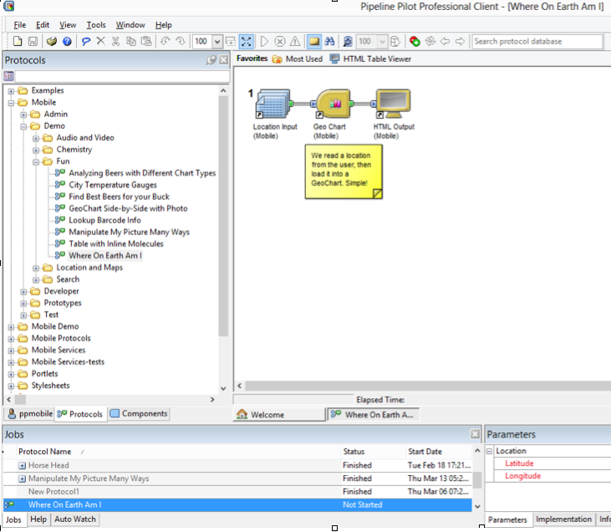
Pipeline Pilot Protocols are Easily ‘Mobilized’

Slide 15
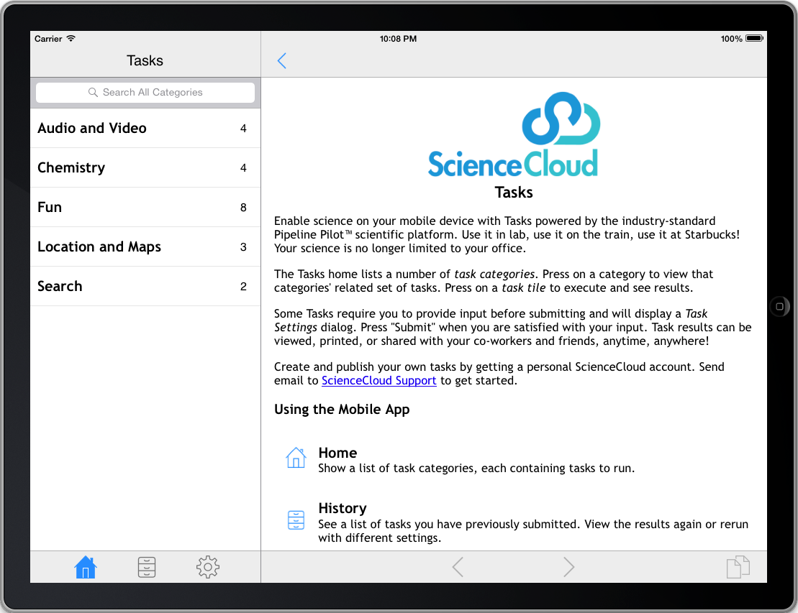
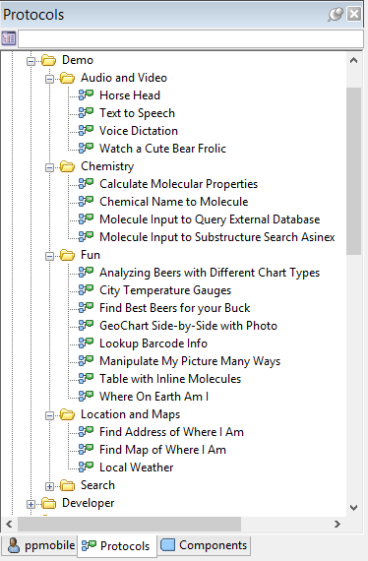
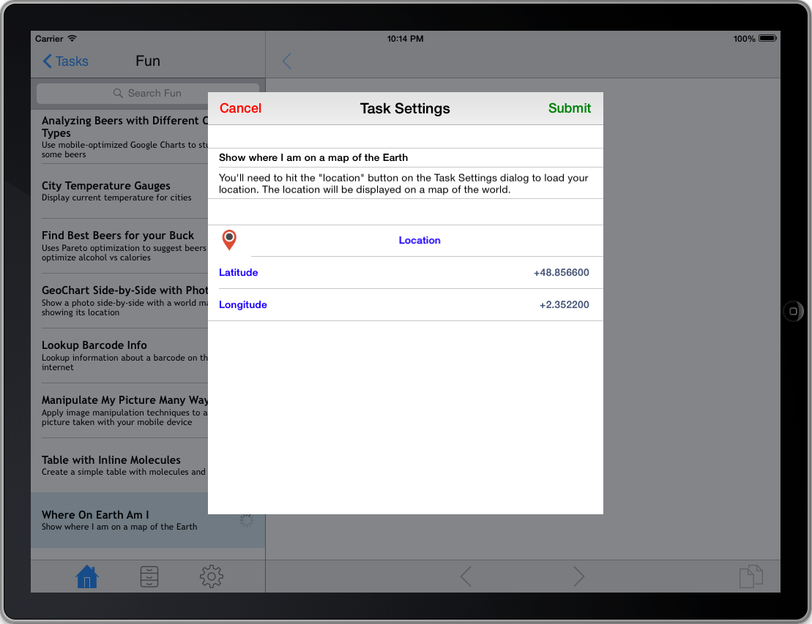
Protocol Folders Appear in the Tasks App

Slide 16
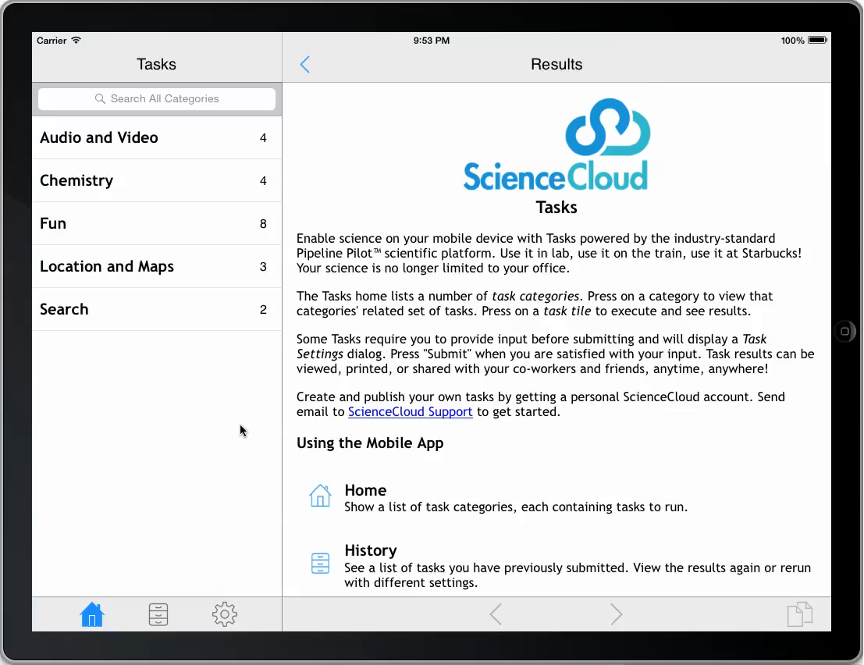
Location (Demo)

Slide 17
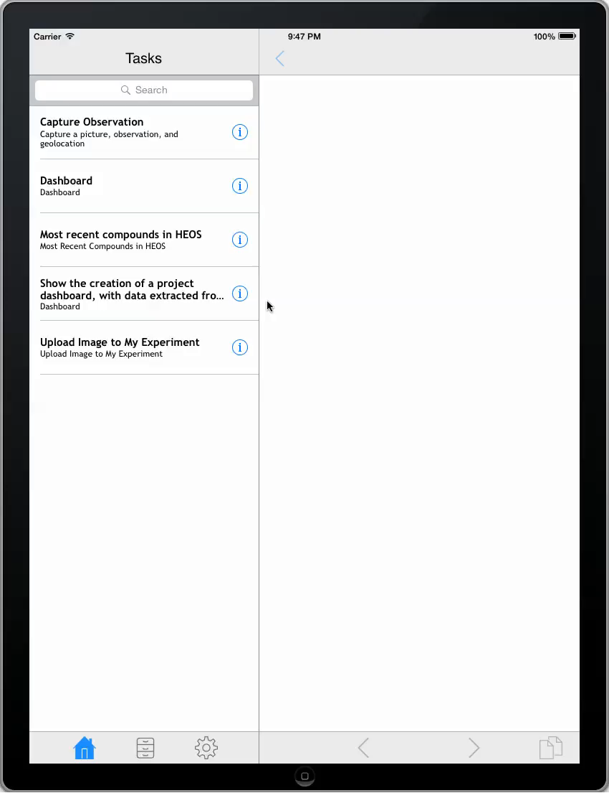

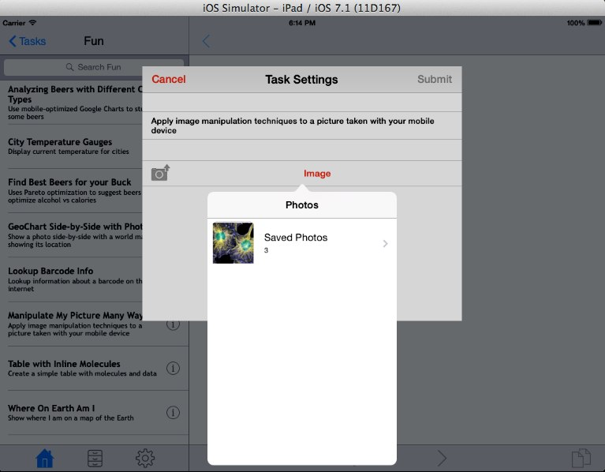

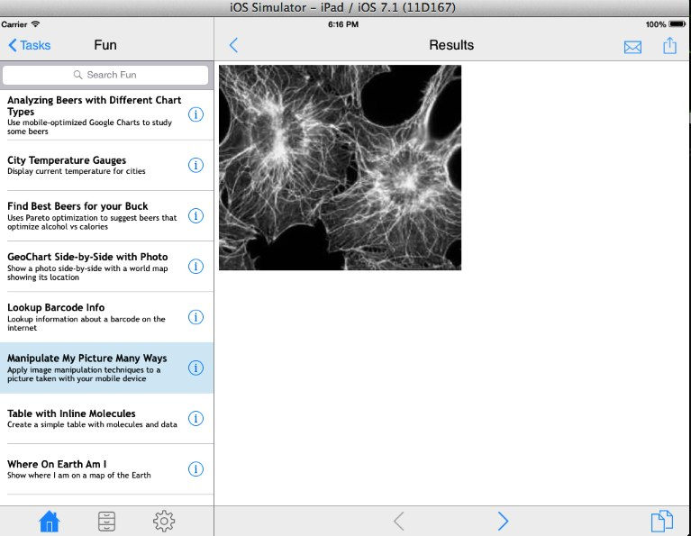
Observation Capture (Demo)
  Leverage Mobile Device Capabilities
Camera, Audio, GPS, etc.

Slide 18

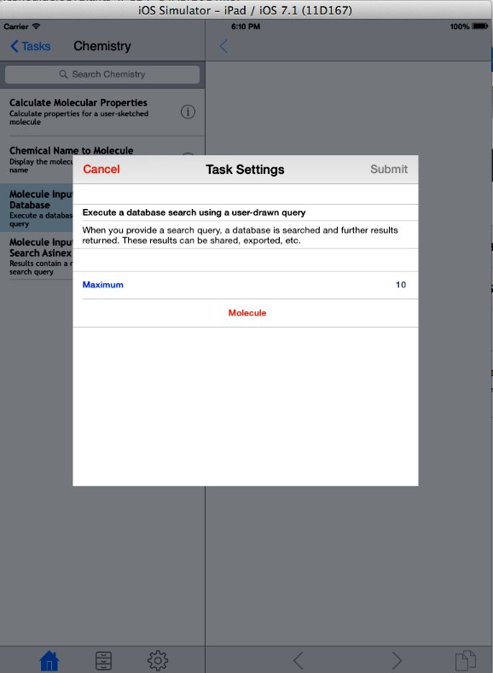

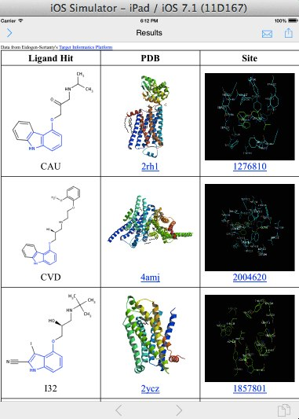

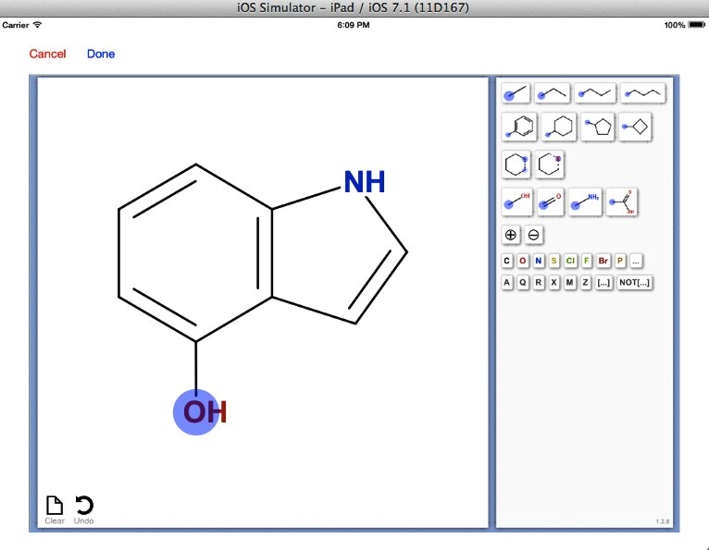
Embed and Deploy
  Embed full applications within Pipeline Pilot protocols and deploy to mobile users

Slide 19
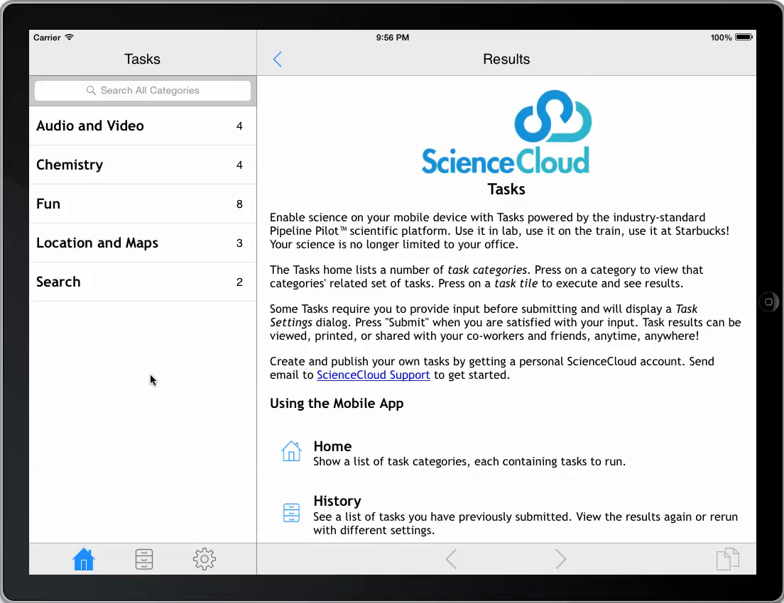
Ligand Co-Complex Search (Demo)

Slide 20
Summary
Billions of people routinely use and connect with mobile devices.
Massive worldwide connectivity is unprecedented.
Well deployed social media frameworks are in-place and easy to access.
  e.g. Facebook, Twitter, and their APIs.
Science apps have been largely insular, vertical, and point solutions. We need to recruit more of the world!
Cloud-based pipelining-tools, social media frameworks, and mobile devices together open many new possibilities

Slide 21
Acknowledgements
Accelrys
  Matt Hahn
  Dave Rogers
  Jung Ku
  Mike Peeler
  Ton van Daelen
  Maurizio Bronzetti
  Stephan Schurer
  Alex Clark

Slide 23
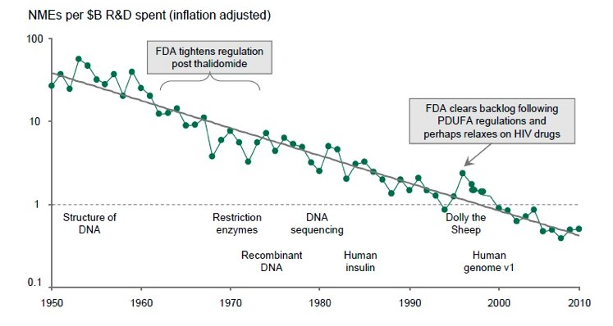
R&D Productivity Has Been On The Decline

Slide 24
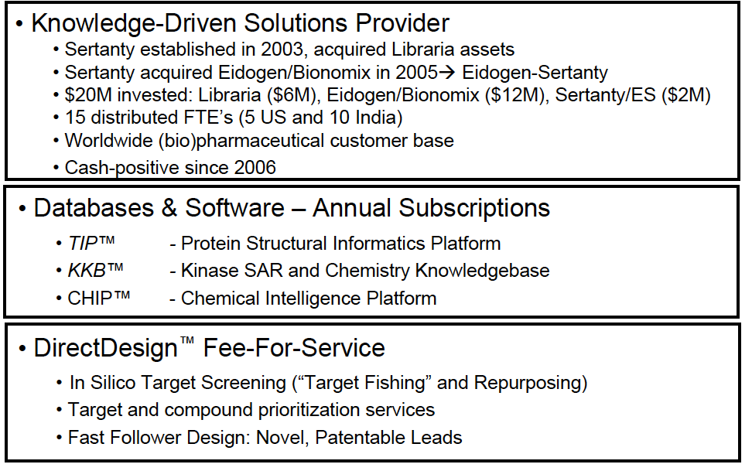
About Eidogen-Sertanty, Inc.

